Slide 1
1 Peter 4:12-19

Slide 2
The Salvation of the Soul

Slide 3
Salvation of the Soul
1 PETER
What is the Salvation of the Soul?
The Salvation of the soul is the total transforming work of God upon our lives, which is presently being realized in the midst of Christ like suffering, and which in the future will be unveiled in Christ like glory.

Slide 4
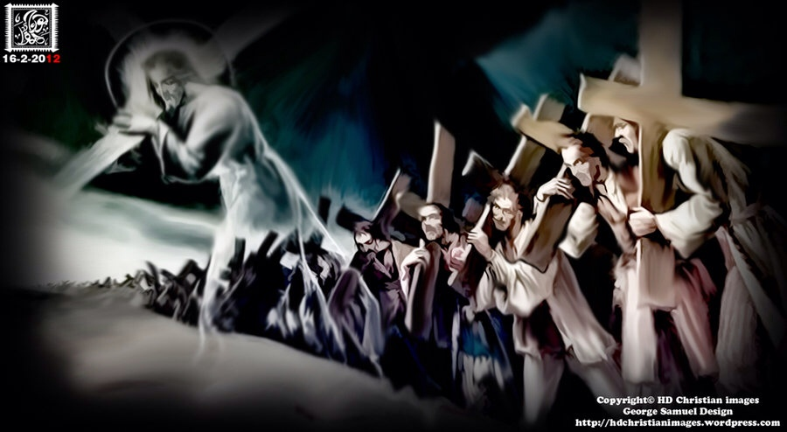
Salvation of the Soul
1 PETER
We are called to patiently endure unjust suffering just as Christ showed us the way to suffer.
Notes:
The example set before us is set in the past. Jesus shows us the way to suffer, to die, to live. We follow Him in the way to suffer and in the way of submission. Christ’s sufferings are the model on how to respond to injustice, for He experienced the greatest injustice of all. So we too are told to take up your suffering and follow Him in His footsteps. There are many others in the past who have taken up their crosses and suffered for Him patiently, will you do the same?

Slide 5
Salvation of the Soul
1 PETER
Outline

Slide 6
Salvation of the Soul
1 PETER
Body: Salvation of the Soul, Worked out in Experience – 1:13 – 4:19
In Relation:
to God – 1:13-21
to Brethren – 1:22 – 2:10
to the World – 2:11 – 3:7
to Life Itself – 3:8 – 4:6
to the Consummation of History – 4:7-19

Slide 7
Salvation of the Soul
1 PETER
In Relation to the End through Service to God
“But the end of all things is at hand; (4:7a)
“the end” – “telos” - the conclusion of an act or state; (termination) the result.
The Question is, what is the end of all things, and is it the same as the end of the age?
Notes:
Question? What is the end of all things and is it the same as the end of the age? The answer to the second part is, No! To answer this question we have to look at Daniel 9.

Slide 8
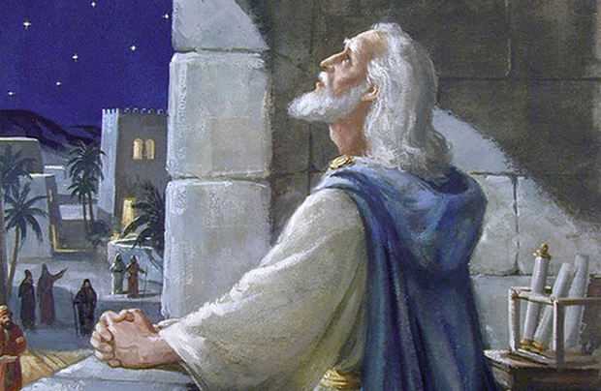
Salvation of the Soul
1 PETER
Daniel’s Understanding – 9:1-2
“…in the first year of King Darius reign I, Daniel, understood by the books the number of the years specified by the word of the Lord through Jeremiah the prophet (25:11; 29:10), that He would accomplish seventy years
in the desolations of Jerusalem.”

Slide 9
Salvation of the Soul
1 PETER
Daniel’s Understanding – 9:1-2
“…this whole land shall be a desolation and an astonishment, and these nations shall serve the king of Babylon seventy years…” (Jer. 25:11)
“thus says the Lord: After seventy years are completed at Babylon, I will visit you and perform My good word toward you, and cause you to return to this place.” (Jer. 29:10)
Notes:
Daniel knows from Jeremiah that the seventy years has come to a conclusion. But why seventy years?

Slide 10
Salvation of the Soul
1 PETER
Daniel’s Understanding – 9:1-2
“And the Lord God of their fathers sent warnings to them by His messengers… But they mocked the messengers of God, despised His words, and scoffed at His prophets, until the wrath of the Lord arose against His people… Therefore He brought against them the king of the Chaldeans…”
Notes:
But first we must remember that they were taken away in captivity in the first place because of their rebellion against the LORD.
2 Chron. 36:15-19
“And the Lord God of their fathers sent warnings to them by His messengers, rising up early and sending them, because He had compassion on His people and on His dwelling place. But they mocked the messengers of God, despised His words, and scoffed at His prophets, until the wrath of the Lord arose against His people, till there was no remedy. Therefore He brought against them the king of the Chaldeans, who killed their young men with the sword in the house of their sanctuary, and had no compassion on young man or virgin, on the aged or the weak; He gave them all into his hand. And all the articles from the house of God, great and small, the treasures of the house of the Lord, and the treasures of the king and of his leaders, all these he took to Babylon. Then they burned the house of God, broke down the wall of Jerusalem, burned all its palaces with fire, and destroyed all its precious possessions.”

Slide 11
Salvation of the Soul
1 PETER
Daniel’s Understanding – 9:1-2
“who killed their young men with the sword in the house of their sanctuary, and had no compassion… And all the articles from the house of God, great and small, the treasures of the house of the Lord, and the treasures of the king and of his leaders, all these he took to Babylon.

Slide 12
Salvation of the Soul
1 PETER
Daniel’s Understanding – 9:1-2
“Then they burned the house of God, broke down the wall of Jerusalem, burned all its palaces with fire, and destroyed all its precious possessions. (2 Chron. 36:15-19)

Slide 13
Salvation of the Soul
1 PETER
Daniel’s Understanding – 9:1-2
“And those who escaped from the sword he carried away to Babylon, where they became servants to him and his sons until the rule of the kingdom of Persia, to fulfill the word of the Lord by the mouth of Jeremiah, until the land had enjoyed her Sabbaths. As long as she lay desolate she kept Sabbath, to fulfill seventy years.” (2 Chron. 36:20-21)
Notes:
The length of time they would remain in Babylon was determined by the number or years they failed to keep the Sabbath year.
Lev. 25:1-5
“And the Lord spoke to Moses on Mount Sinai, saying, ‘Speak to the children of Israel, and say to them: 'When you come into the land which I give you, then the land shall keep a sabbath to the Lord. Six years you shall sow your field, and six years you shall prune your vineyard, and gather its fruit; but in the seventh year there shall be a sabbath of solemn rest for the land, a sabbath to the Lord. You shall neither sow your field nor prune your vineyard.”

Slide 14
Salvation of the Soul
1 PETER
Daniel’s Understanding – 9:1-2
490 Y
70 years
No Rest
Rest
70 years for 70 Sabbaths

Slide 15
Salvation of the Soul
1 PETER
Daniel’s Prayer – 9:3-16
“Then I set my face toward the Lord God to make request by prayer and supplications… And I prayed to the Lord my God, and made confession…
…according to all Your righteousness, I pray… because of Your great mercies. O Lord, hear!... forgive!... listen and act! Do not delay for Your own sake, my God, for Your city and Your people…”

Slide 16
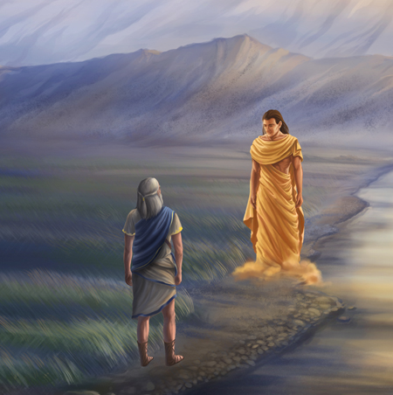
Salvation of the Soul
1 PETER
Daniel’s Visitor – 9:17-24
“…yes, while I was speaking in prayer, the man Gabriel, whom I had seen in the vision at the beginning, being caused to fly
swiftly, reached me about the
time of the evening offering…”

Slide 17
Salvation of the Soul
1 PETER
Daniel’s Vision – 9:24-27
“Seventy weeks [sevens] are determined for your people and for your holy city…
“from the going forth of the command to restore and build Jerusalem until Messiah the Prince [commander], there shall be seven sevens and sixty-two sevens;” (7:25)
Notes:
The KJB, NKJB and the NASB use weeks, but the NIV actually is more accurate by translating the Hebrew as “seventy sevens” and The Living Bible does the math for us “490 years”.

Slide 18
Salvation of the Soul
1 PETER
Daniel’s Vision – 9:24-27
“from”
“until”
444 BC
33 AD
490 Y
70 years
483 Y
No Rest
Captivity
No Rest
Rebuild the City
(7 x 7 = 49) + (7 x 62 = 434) + (7) = 490 Years
Notes:
At this point many Biblical scholars, commentaries kick into what is called “Genre Override”. A Genre is a category of composition, as in music or literature, characterized by similarities in form, style or subject matter; i.e.: poetry, history, science fiction, novel, biography; jazz, rock-in-roll, classical music, etc.
These Biblical scholars categorize all unfulfilled prophecy by subject matter as “Apotolitic Literature”. AL was developed in the inter-Testament period during the Greek occupation of the Palestine. Some Hebrew authors wrote metaphoric or allegorical interpretations, commentaries on Daniel and other OT scriptures. These non-inspired, non-canonical books and their metaphoric genre type was then superimposed back into the inspired Word, and their metaphoric interpretation. And this “Genre Override” is also superimposed forward in the NT and applied to all unfulfilled prophecy, as in the Olivet Discourse (Mt. 24-25) and of course the book of Revelation.
Literalist, or better yet realist or normalist considered all unfulfilled prophecies of Joel, Daniel, Ezekiel, Zechariah, etc. as not “Apotolitic Literature” They are not to be interpreted as a whole metaphorically at all. The inspired Scriptures were all written hundreds of years before metaphoric Apotolitic Literature was developed. Even the book of Revelation should not be considered categorically A.L. Even though there is within the book the use of allegory, figures of speech, symbolic language and numbers, and even metaphors. It should be included in the genre type of future prophecy, not A.L.
That all being said, Daniel’s seventy sevens are to be interpreted normally as 490 literal historical years. These calculations are based on a 360 day year, by the Hebrew calendar.

Slide 19
Salvation of the Soul
1 PETER
Daniel’s Vision – 9:24-27
“Seventy weeks [sevens] are determined for your people and for your holy city…
“And after the sixty-two weeks Messiah shall be cut off… and the people of the commander who is to come shall destroy the city and the sanctuary. The end of it shall be with a flood…” (9:26)

Slide 20
Salvation of the Soul
1 PETER
Daniel’s Vision – 9:24-27
“from”
“until”
444 BC
33 AD
“after”
490 Y
70 years
483 Y
? Y
No Rest
Captivity
No Rest
[Church]
Rebuild the City
Completion
(7 x 7 = 49) + (7 x 62 = 434) + (7) = 490 Years
Notes:
After the 69 sevens two things occur: 1) the Messiah is “cut off”, that is killed; and 2) Jerusalem is destroyed. A third things occurs, but it is not mentioned in Daniel’s prophecy because it was hidden in God, that is, not revealed in the OT, until after Israel rejected the coming of their Messiah.

Slide 21
Salvation of the Soul
1 PETER
Daniel’s Vision – 9:24-27
“Seventy weeks [sevens] are determined for your people and for your holy city…
“Then he shall confirm a covenant with many for one seven; But in the middle of the seven He shall bring an end to sacrifice and offering. And on the wing of abominations shall be one who makes desolate…” (9:27a)

Slide 22
Salvation of the Soul
1 PETER
Daniel’s Vision – 9:24-27
“from”
“until”
“then”
444 BC
33 AD
“end”
“after”
490 Y
70 years
483 Y
7 Y
? Y
No Rest
Captivity
No Rest
[Church]
signs
Rebuild the City
Completion
(7 x 7 = 49) + (7 x 62 = 434) + (7) = 490 Years
Notes:
Some say that the abomination of desolation took place already in the distant past. Not so. Jesus mentions it in the Olivet Discourse as something still future. Others say it was fulfilled at the time the Romans destroyed the temple in AD 70. But there is no historical record or proof that such a thing took place. A normal reading leads one to conclude that it is still a future event as described by Jesus and John, in a future third temple that will be built and destroyed.

Slide 23
Salvation of the Soul
1 PETER
Daniel’s Vision – 9:24-27
“Seventy weeks [sevens] are determined for your people and for your holy city…
“…Even until the consummation, which is determined, is poured out on the desolate.“ (7:27b)
This is the End of the Age Accompanied by Signs and Wonders
Notes:
The end of the age is the end of the seventy sevens.

Slide 24
Salvation of the Soul
1 PETER
“the end of all things is near” (1 Peter 4:7)
The End of the Age
New Heaven and Earth
“no signs”
“signs”
483 Y
? Y
7 Y
1000 Y
Eternity
No Rest
Church
Day of the LORD
Kingdom
Day of the God
The Completion of All Things
Notes:
The Day of the Lord, Daniel’s seveneith seven, the Coming of the Lord in wrath is preceded by no signs. The Day of LORD and Jesus, the Christ will come like a thief in the night. This why we need to be watching and alert in prayer like Daniel.
If we are seeing “signs” today of His coming as a thief in the night, then He is a bad thief, tipping off when He is coming. The signs are for that generation that will be living during the fulfillment of Daniel’s seventieth seven.

Slide 25
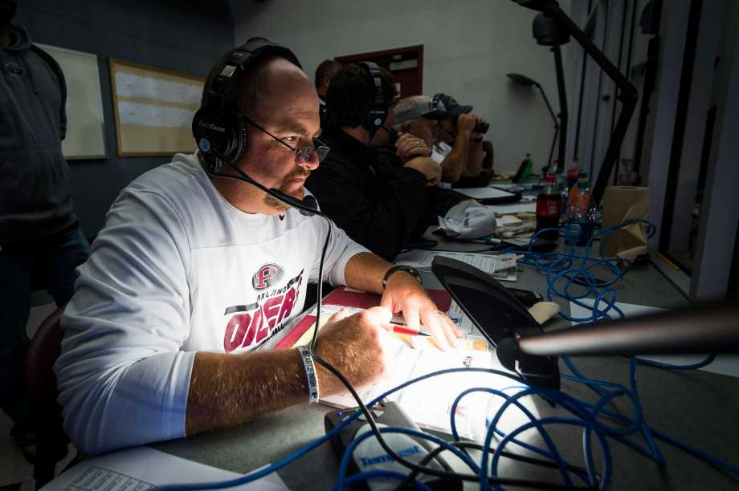
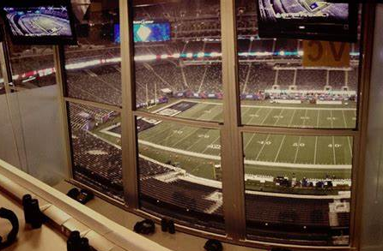
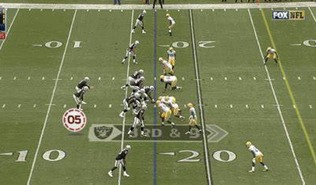
Salvation of the Soul
1 PETER
Christ’s Management in the Church
Offensive Coordinator
The Dispensation
of the Grace of God
Notes:
A football analogy… showing the different managements types or the dispensing of God’s rule in the church age and the kingdom age.

Slide 26
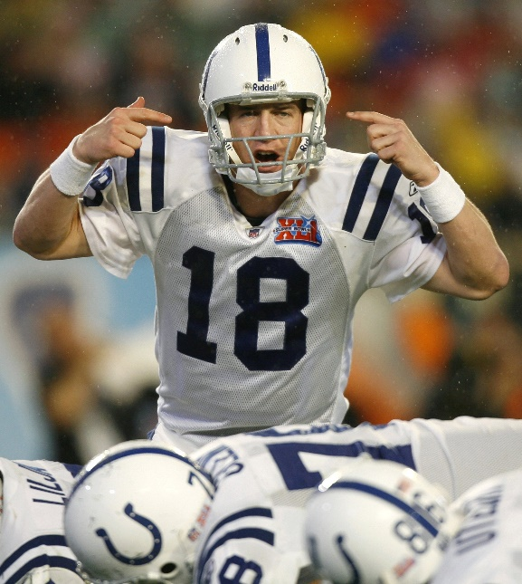
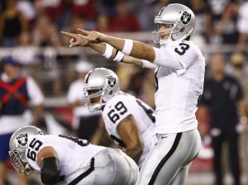
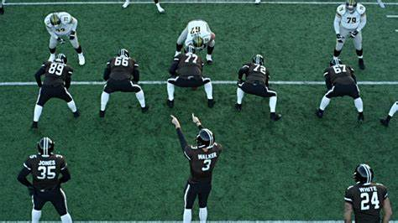
Salvation of the Soul
1 PETER
Christ’s Management in the Kingdom
Quarterback Calls Plays
on the Field
The Dispensation
of the Fullness of Times

Slide 27
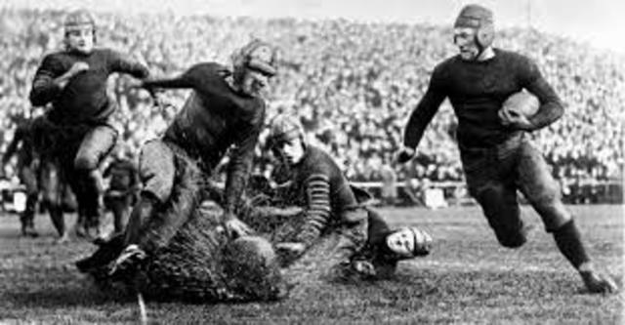
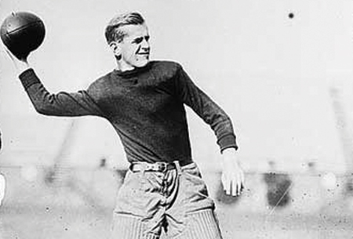
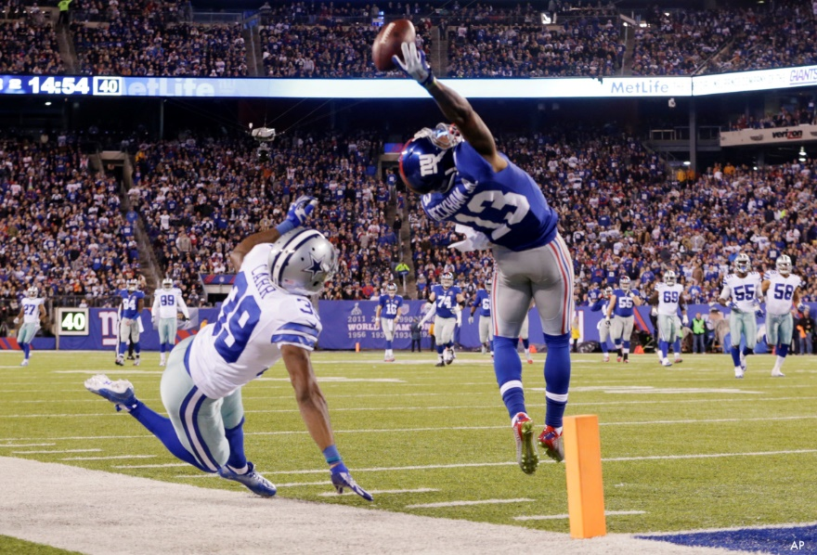
Salvation of the Soul
1 PETER
Rules Change
Pass Play
Run Play
Notes:
There are different era’s of football. One before the forward pass and the one afterwards. It change the way the game was played. So it is with the Old testament and the New. Different rules, a different play book.

Slide 28
Salvation of the Soul
1 PETER
Body: Salvation of the Soul, Worked out in Experience – 1:13 – 4:19
In Relation:
to the Consummation of History – 4:7-19
through Service to God – 4:7-11
through Suffering for God – 4:12-19

Slide 29
Salvation of the Soul
1 PETER
In Relation to the End through Service to God
With Prayer – 4:7b
With Love – 4:8
With Hospitality – 4:9
With His Gift – 4:10-11a
All for the Glory of God – 11:b
Notes:
Since the end of all things is near this leads us to soberness and prayer, (7b) love and hospitality, (8-9) and to God honoring service (10-11).
Peter describes how to live life with an end-time perspective.

Slide 30
Salvation of the Soul
1 PETER
“But the day of the Lord will come as a thief in the night, in which the heavens will pass away with a great noise, and the elements will melt with fervent heat; both the earth and the works that are in it will be burned up. Therefore, since all these things will be dissolved, what manner of persons ought you to be in holy conduct and godliness,” (2 Peter 3:10-12)

Slide 31
Salvation of the Soul
1 PETER
In Relation to the End through Suffering for God
With Great Rejoicing – 4:12-13
With Anticipated Blessing – 4:14
Not as an Evil Doer, but as a Christian– 4:15-16
With Coming Judgment in Mind - 4:17-18
With Commitment to God - 4:19

Slide 32
Salvation of the Soul
1 PETER
In Relation to the End through Suffering for God
With Great Rejoicing – 4:12
“Beloved, do not think it strange concerning the fiery trial which is to try you, as though some strange thing happened to you;…”
Notes:
Peter begins this section by telling his readers how not to respond to trials, using the imagery, a figure of speech, of metallurgy, the refining or purification of metals. “The figure is that of metal being subjected to a refiner’s blazing hot fire that burns away the impurities”. (GNTC, p. 1165)
Some commentators suggest that Peter was referring to Nero’s burning of Christians, covering them with pitch and used as living torches to light the imperial gardens at night. If so, such persecution should not take Christians by surprise.
A “trial” (peirasmon) is any adverse situation brought on us by God’s design. We are grieved by “various” trials (1:6; James 1:2) - persecutions and tribulations = stress.
Peter stated earlier, “…though now for a little while, if need be, you have been grieved by various trials, that the genuineness of your faith, being much more precious than gold that perishes, though it is tested by fire, may be found to praise, honor, and glory at the revelation of Jesus Christ.” (1:6-7)
Trials are not to be regarded as “strange” or a “surprise” to the Christian experience. It should be expected. Suffering for Christ is not a foreign experience, though suffering for sin ought to be. If we suffer for sin we suffer needlessly for Christ suffered on the cross of our sins. Later, Peter will say that no Christian ought to suffer as an evil doer. Christians are foreigners or strangers in this evil world, at this time, but not foreigners of suffering for Christ.
You’ll are presently being refined by God through various trials. You’ll work will also be refined in the future at the Judgment Seat of Christ.
“…each one's work will become clear; for the Day will declare it, because it will be revealed by fire; and the fire will test each one's work, of what sort it is. If anyone's work which he has built on it endures, he will receive a reward. If anyone's work is burned, he will suffer loss; but he himself will be saved, yet so as through fire” (1 Cor. 3:10-15)

Slide 33
Salvation of the Soul
1 PETER
In Relation to the End through Suffering for God
With Great Rejoicing – 4:13
“…but rejoice to the extent that you partake of Christ's sufferings, that when His glory is revealed, you may also be glad with exceeding joy.”
Notes:
Peter contrasts “but” the proper response with rejoicing. “…count it all joy when you encounter various trials” (James 1:2)
Suffering is a means of obtaining fellowship with the Messiah, “of Christ” leading to exaltation “glory” and triumphant joy. Those who “partake” “participate” or literally share “koinoneo” have fellowship with Christ’s suffering. We suffer like Christ suffered and follow in His footsteps, when we are mocked, insulted or physically wounded as He was. As Jesus’ representatives on earth, we may suffer and are hated in His place as the world rejects Him through us. Remember what Jesus said, "If the world hates you, you know that it hated Me before it hated you.” (John 15:18)
“But” you should rejoice be glad, be happy exceedingly, literally “with jumping joy”. The sufferings for Christ is a cause for leaping joy, because of the accompanying reward it will bring, partakers of His glory. (5:1) As Paul said in Col 3:4, “When Christ who is our life appears, then you also will appear with Him in glory.”
The recipients of the book Hebrews experience something similar, “But recall the former days in which, after you were illuminated, you endured a great struggle with sufferings: partly while you were made a spectacle both by reproaches and tribulations, and partly while you became companions of those who were so treated; for you had compassion on me in my chains, and joyfully accepted the plundering of your goods, knowing that you have a better and an enduring possession for yourselves in heaven. Therefore do not cast away your confidence, which has great reward…” (Heb. 10:32-35)

Slide 34
Salvation of the Soul
1 PETER
In Relation to the End through Suffering for God
With Anticipated Blessing – 4:14
“If you are reproached for the name of Christ, blessed are you, for the Spirit of glory and of God rests upon you. On their part He is blasphemed, but on your part He is glorified.”
Notes:
“If” means that we may not always be, but when we are “reproached” oneidizo (on-i-did'-zo); - defame, rail at, chide, taunt, insulted, slandered, looked down upon by the world, we are “blessed” makarios (mak-ar'-ee-os); supremely blest; “happy”. We should consider ourselves to be fortunate, or well off.
Being persecuted for Christ’s sake and presently experiencing various trials is a normal part of God’s refining fire of life. Peter actually states that persecution is a sign of great blessing from God. Jesus said the same thing,
Matt 5:11-12
“Blessed are you when they revile and persecute you, and say all kinds of evil against you falsely for My sake. Rejoice and be exceedingly glad, for great is your reward in heaven, for so they persecuted the prophets who were before you.”
“happy are you, for this reason the spirit of glory and of God…” [KJV] or the glory and God the Spirit is upon you [NKJV], even rests of you” anapano (an-ap-ow'-o) – “to remain”, has taken up residents.
We may experience a similar experience as Christ, “And immediately, coming up from the water, Jesus saw the heavens parting and the Spirit descending upon Him like a dove. Then a voice came from heaven, "You are My beloved Son, in whom I am well pleased.” (Mark 1:10-11)
“And John bore witness, saying, "I saw the Spirit descending from heaven like a dove, and He remained upon Him.” – “meno” (men'-o); a primary verb; to stay; abide, continue, dwell, endure”. (John 1:32-33)
Suffering for Christ then is a sign that God’s Spirit is in us or rests upon us, in order to strengthen us in the midst of persecution. Jesus said he sent to Holy Spirit to be alongside of us and teach us what to say in that very moment. (Luke 12:11-12)
The world may blasphemeo (blas-fay-meh'-o); to vilify; specially, to speak evil of or against: defame, revile, but you are glorified, “doxazo” (dox-ad'-zo); to render (or esteem) glorious.

Slide 35
Salvation of the Soul
1 PETER
In Relation to the End through Suffering for God
Not as an Evil Doer, but as a Christian – 4:15-16
“But let none of you suffer as a murderer, a thief, an evildoer, or as a busybody in other people's matters. Yet if anyone suffers as a Christian, let him not be ashamed, but let him glorify God in this matter.”
Notes:
Not all suffering by Christians is for Christ’s sake and glory. There is both deserved and underserved suffering. Christians may suffer justly and needlessly for sin or suffer unjustly for Christ.
The list goes from the worst criminal actions (murder and stealing) to the least (busybody). An evildoer refers to someone guilty of malicious and hateful conduct though bad is not criminal. A busybody is someone who gets into every bodies and no bodies personal business. Christians should stay out of anything that justifiably turns people against us.
We know this that Moses and Paul reminds us “…the commandments, "You shall not commit adultery," "You shall not murder," "You shall not steal,“ (Rom. 13:9)
Is it possible for a Christian to commit murder and still be eternally saved? Some say, no way,
“Whoever hates his brother is a murderer, and you know that no murderer has eternal life abiding in him.” (1 John 3:15)
“But the cowardly, unbelieving, abominable, murderers, sexually immoral, sorcerers, idolaters, and all liars shall have their part in the lake which burns with fire and brimstone, which is the second death.” (Rev 21:8) “Blessed are those who do His commandments, that they may have the right to the tree of life, and may enter through the gates into the city. But outside are dogs and sorcerers and sexually immoral and murderers and idolaters, and whoever loves and practices a lie.” (Rev 22:14-15)
James speaking to the brothers, (How many times does he call them brothers?) says, “You lust and do not have. You murder and covet and cannot obtain. You fight and war.” (4:2) “You have condemned, you have murdered the just;” (5:6)
What is strange is a Christian suffering for wrong doing, for being a bad dude, especially suffering for criminal offenses. But it is possible.
Roger Raymer in the Bible Knowledge commentary says Peter is stressing that persecution was no excuse for lawlessness and vigilante activity, taking the law into our own hand. Christians are not to retaliate, “…not returning evil for evil or reviling for reviling, but on the contrary blessing…” (3:9). Physical violence was not to be met by murder. Confiscation of property was not to be compensated for by theft. We are to do nothing that would justify punishing us as a criminal.

Slide 36
Salvation of the Soul
1 PETER
In Relation to the End through Suffering for God
Not as an Evil Doer, but as a Christian – 4:15-16
“But let none of you suffer as a murderer, a thief, an evildoer, or as a busybody in other people's matters. Yet if anyone suffers as a Christian, let him not be ashamed, but let him glorify God in this matter.”
Notes:
“yet if” reminds us that being a good citizen does not guarantee a peaceful life in this evil world and age. “yet if” assumes the possibility of suffering as a Christian. A Christian is someone who is not just a believer and has eternal life, but is also a follower of Christ, who is living the life of a Christian and proclaiming Christ before men, exposing themselves to ridicule.
The right response is not to be ashamed (not surprise), but to glorify God all the more. This is by the means either “to praise” verbally (give God glory) or to live in such a way that it brings Him glory.

Slide 37
Salvation of the Soul
1 PETER
In Relation to the End through Suffering for God
With Coming Judgment in Mind – 4:17-18
“For the time has come for judgment to begin at the house of God; and if it begins with us first, what will be the end of those who do not obey the gospel of God?”
Notes:
This verse explains “for” both verses 15-16. The time and time is even now to “begin” “pronto” or “to commence” the judgment “krima” of the “house of God” for “the Judge standing at the door!” (James 5:19)
Elsewhere in Scripture the “house of God” referred to the physical temple (Mt. 12:4; Mk. 2:26; Luke 6:4) or the church. Paul writes, “I write so that you may know how you ought to conduct yourself in the house of God, which is the church of the living God, the pillar and ground of the truth.” (1 Tim. 3:15)
Judgment can also mean vindication. Christian will be judge and vindicated by the refining process. If Christians suffer in this process, you can only imagine what will be the end result “telos” of those who do not obey the gospel of God” Those who do not obey are those who do not do the will of the Father and believe in His commandment to believe in His Son so that they may receive eternal life. They disbelieve”, they are not convinced by arguments or reason, unpersuaded by the good news, the message of life.
If Christian suffer for doing good is this evil world, the unbelieving and disobedient will certainly not escape a punishing judgment. The temporal sufferings of believers as a result of sin, acts as a visual example to the unbelieving world that judgment from God is coming someday for them.

Slide 38
Salvation of the Soul
1 PETER
In Relation to the End through Suffering for God
With Coming Judgment in Mind – 4:17-18
“Now ‘If the righteous one is scarcely saved, where will the ungodly and the sinner appear?”
Notes:
Peter affirms the certainty of coming judgment of the wicked by now quoting Proverbs 11:31, “Now ‘If the righteous one is scarcely saved, where will the ungodly and the sinner appear?”
The “righteous” are those in the house of God and if they suffer for wrong doing, if they do not get away with sin, God will certainly not let the ungodly and the sinner get away with anything. They do not have a chance!
The righteous are “sacarcely” molis (mol'-is), “saved” - “sozo” with difficulty: with much work.
Remember, we are talking about the “Salvation of the Soul”, the “psuche”, not the salvation for “zoe” life. Are the righteous barely saved by their much work from eternal judgment? No, the righteous are eternally saved from sin by the work of Christ on the cross. Here the righteous save their soul “psuche” with great difficulty, with much work. The righteous, the doer of good who loses his soul will save his soul. Those who sought to save their soul “psuche” by seeking after wicked pursuits will lose their “soul”. Where will they “appear”, literally “where shall they be”.

Slide 39
Salvation of the Soul
1 PETER
In Relation to the End through Suffering for God
With Commitment to God – 4:19
“Therefore let those who suffer according to the will of God commit their souls to Him in doing good, as to a faithful Creator.”
Notes:
Peter applies the truth “therefore” with a command to those who suffering righteously. The doer of good is to commit their souls, their life to a Creator who is faithful. He can be trusted, even in the midst of great suffering. He knows what He is doing. He is not like a shifting shadow, but is immutable, never changing in His love for us. We can bank of God in doing what is right!

Slide 40
Salvation of the Soul
1 PETER
Conclusion
Notes:
Peter’s letter has show us how to do good or well in every area of our present experience. We have seen how to do well in regard to God, the church, the world, to life in general and in the light of the end of all things. If in all these areas we indeed so well/good, the soul is safe in the hands of a trustworthy and loving God. He will preserve our soul and save it so that it may survive even death itself and appear to His eternal glory in the age to come. “He that doeth the will of God abides forever.” (1 Jn. 2:17)

